Slide 1
The Future of Talent Management and People Analytics
Tuesday, November 10, 2020
Notes:
\

Slide 2
Meet Your Presenters
Holly Larson
Sr. HR Technology Consultant
Asheville, NC
Jessica Daily
HR Technology Manager
Chattanooga, TN
Notes:
Kelli

Slide 3
Talent is changing (almost) daily
Workers are expecting to work longer than ever before
Tenure has decreased, especially in the 25-34 demographic
Talent strategy must address these changing dynamics
Notes:
Workers are working longer hours it feels like thanks to the pandemic
But workers are also planning on staying in the workforce longer
Longevity of careers – due to easily attainable skills and soft skills

Slide 4
People Analytics Provides Ongoing Insights About Your Workforce
Marsh & McLennan Agency LLC | MMA Technology Solutions
Notes:
Kelli

Slide 5
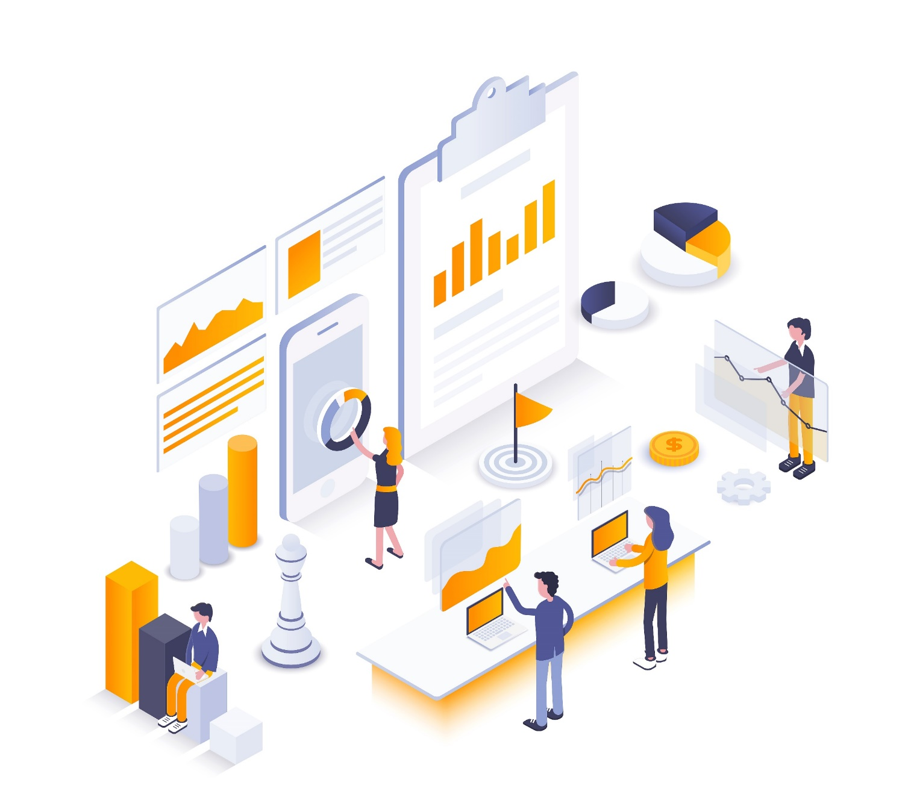
and it’s not just talent or HR data
Sales
Financials
Operations
Supply chain
Customers
Applicant Tracking
Onboarding
Compensation & Benefits
Performance
Learning
Engagement
Payroll
Notes:
Holly
Not a complete list but these are some of the services a ben admin point solution can have…

Slide 6
Engagement
Talent Acquisition
Onboarding
Workforce Planning
Talent
Management
Performance
Succession Planning
Development
Compensation
© 2020 Benefit Technology Resources – Confidential & Proprietary Information – Not for Distribution
Notes:
Talent management is so much more than ATS or recruiting.
People analytics provides the opportunity for real time assessments of employees, not looking at a point in time 6 months ago, and can get insights and feedback that are applicable now.
For example: workforce planning allows you to see who has availability; what department has the most high performers and why? Who has someone that is ready for their next step, and what skills do they need? How can we promote from within?
Focus on engagement as the glue that binds this all together.

Slide 7
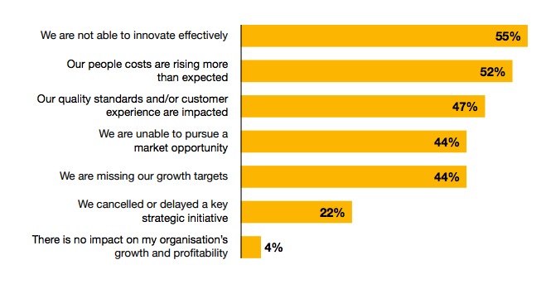
The skills gap is impeding innovation and prompting higher people costs
78% of CEO’s were concerned about the availability of key skills in their organization
Notes:
Think about how much it may cost if you don’t train or upskill your people
So we’ve talked about people analytics internally, but now let’s talk about talent outside of your organization

Slide 8
Inquiry
Talent Pool
Nurture
talent acquisition
Engagement
Application
HIRE
Notes:
Talent acquisition is the combination of talent and applicant tracking together
You not only have candidates applying, but you have candidate sourcing, talent pools, communication (texting, emailing, videos)
Passive candidates
Underemployed
Right person, right time

Slide 9
How does people analytics apply to you?
© 2020 Benefit Technology Resources – Confidential & Proprietary Information – Not for Distribution

Slide 10
Talent & Analytics Explosion
Notes:
Kelli

Slide 11
Point solutions vs. HCM solutions
Point Solutions
Complex talent processes
Enhanced people analytics (AI, Machine learning)
HCM Solutions
Simple or standard talent processes
General people analytics functionality
Notes:
But what about the payroll or HCM vendors out there that offer talent management functionality?

Slide 12
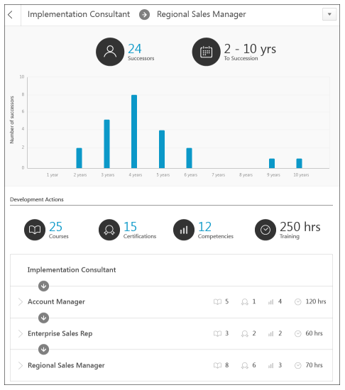
Real time succession planning
Notes:
So let’s take a look at some of those point solutions and the analytics they have

Slide 13
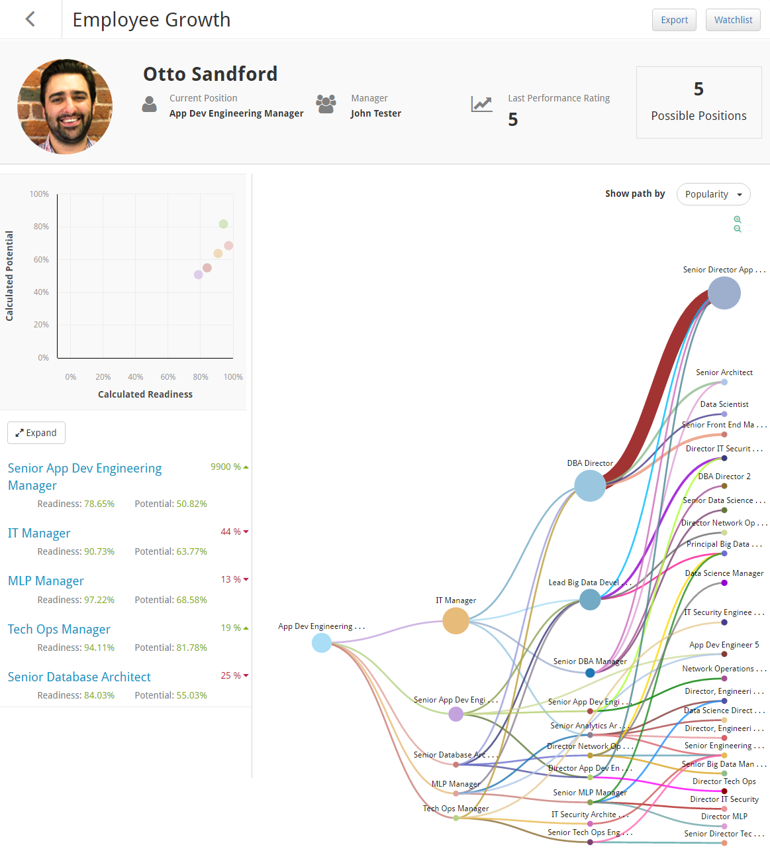
Showcasing
potential for
internal mobility
(how cool is that?)
©2020 Benefit Technology Resources | Confidential & Proprietary Information -Not for Distribution

Slide 14
So what’s the takeaway?
Marsh & McLennan Agency LLC | MMA Technology Solutions

Slide 15
Think about this..
Upskilling of your talent/people
Gaps in skills for future-proofing your business
Internal mobility
Notes:
Holly

Slide 16
Think about this..
Improving an outcome, reducing risk, driving better customer results
Understanding the costs of the business
Notes:
Holly

Slide 17
Focus on strategic outcomes
Good
Better
Best
Reduce administrative time/HR manual effort
Make it easier to report on critical data
Improved adoption
Reduce time to hire/Increase internal hires
Reduce time to productivity
Retain high-potential / performing employees
Increase Revenue (Growth)
Reduce Costs (Profitability)
Mitigate Risk (Liability)
.5 to 2x ROI
8 to10x ROI
Value for HR
Value for Business
Value for Executives

Slide 18
Questions?
Notes:
Holly

Slide 19
SHRM and HRCI
credit codes
will be emailed to attendees
Marsh & McLennan Agency LLC | MMA Technology Solutions

Slide 20
Notes:
Update disclaimer to:
“This document is not intended to be taken as advice regarding any individual situation and should not be relied upon as such. Marsh & McLennan Agency, LLC shall have no obligation to update this publication and shall have no liability to you or any other party arising out of this publication or any matter contained herein. Any statements concerning actuarial, tax, accounting or legal matters are based solely on our experience as consultants and are not to be relied upon as actuarial, accounting, tax or legal advice, for which you should consult your own professional advisors. Any modeling analytics or projections are subject to inherent uncertainty and the analysis could be materially affected if any underlying assumptions, conditions, information or factors are inaccurate or incomplete or should change. Copyright © 2020 Marsh & McLennan Insurance Agency LLC. All rights reserved. CA Insurance LIC 0H18131 . MarshMMA.com”

